Slide 2
Who Are We?
  Set up in 1982, offices across Wales, 60+members of staff
  Delivering projects on behalf of Welsh Government and the European Union
  Our vision: For Wales to be an international leader for co-operative thinking and action
  Our mission: To develop sustainable businesses and strong, inclusive communities by working co-operatively

Slide 3
Two key areas of work
Enterprise
  We will be an important engine for Wales’s economic growth by providing a comprehensive range of services to co-operatives, mutuals social enterprises and employee owned businesses.
Communities
  We will develop and implement co-operative solutions to strengthen communities and promote inclusion.

Slide 4
Getting in on the Act!
Worked with SFW
Promote section 16
Workshops for LA’s
Workshops for SE’s and Third Sector
Models of delivery that engage and empower.

Slide 5
Potential Service Models
Delivered in house by the LA
Wholly owned subsidiary of the LA
Contracted out to commercial market
Contracted out to social enterprise, co-op or third sector
Partnership working-jointly owned SPV
Collaborative working – number of stakeholders in an SPV.

Slide 6
Co-operative Models
Consumer Co-operatives
Worker Co-operatives
Consortia Co-operatives
Multi Stakeholder Co-operatives.

Slide 7

Notes:
To maximise the potential for businesses to contribute to economic growth and sustainability through the establishment of co-operative consortia
Traditional capitalist economy – Price takers.

Slide 8

Notes:
The co-operative way of fighting back.

Slide 9
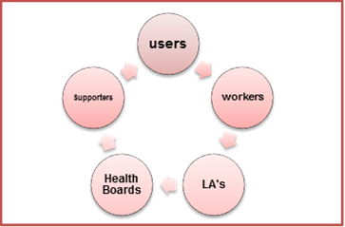
Multi Stakeholder Co-operative
Notes:
A co-operative organisation owned and controlled by its members. Members could include, users of the service, workers delivering the service, commissioners purchasing the service, for example health boards or local authorities.

Slide 10
Care to Co-operate
The project will support the development of social co-operatives and social enterprises across Wales. It will support citizens to come together to develop co-operative solutions in the field of social services and well being.

Slide 11
Clients include:
A co-operative of stakeholders supporting people experiencing dementia, which includes citizens, trainers and the workforce.
A co-operative consortium of third sector organisations preparing to bid for learning disability service contracts.

Slide 12
Clients include:
Co-operative approaches to designing alternative future models of domiciliary care with partners from the local authority, the CVC and third sector organisations.
Artists forming a co-operative with people who experience sensory loss and mental health issues, to use creative arts, to increase their well-being and social inclusion.

Slide 13
How to commission
Support small local charities and voluntary orgs to deliver well being and preventative services – “Giving”
Contract with established social enterprises and co-ops to deliver services - “Shopping”
Facilitate the setting up new jointly owned SPV’s to deliver services – “Investing”

Slide 14
Barriers & Challenges
Political buy in from potential stakeholders
Finance
Technical expertise
Staff & staff training
Potential TUPE issues
Displacement
Member engagement and training
Business support
Winning contracts

Slide 15
Contact Details
Glenn Bowen
Mobile: 07775 512311
Email: glenn.bowen@wales.coop
Questions ?

Slide 16
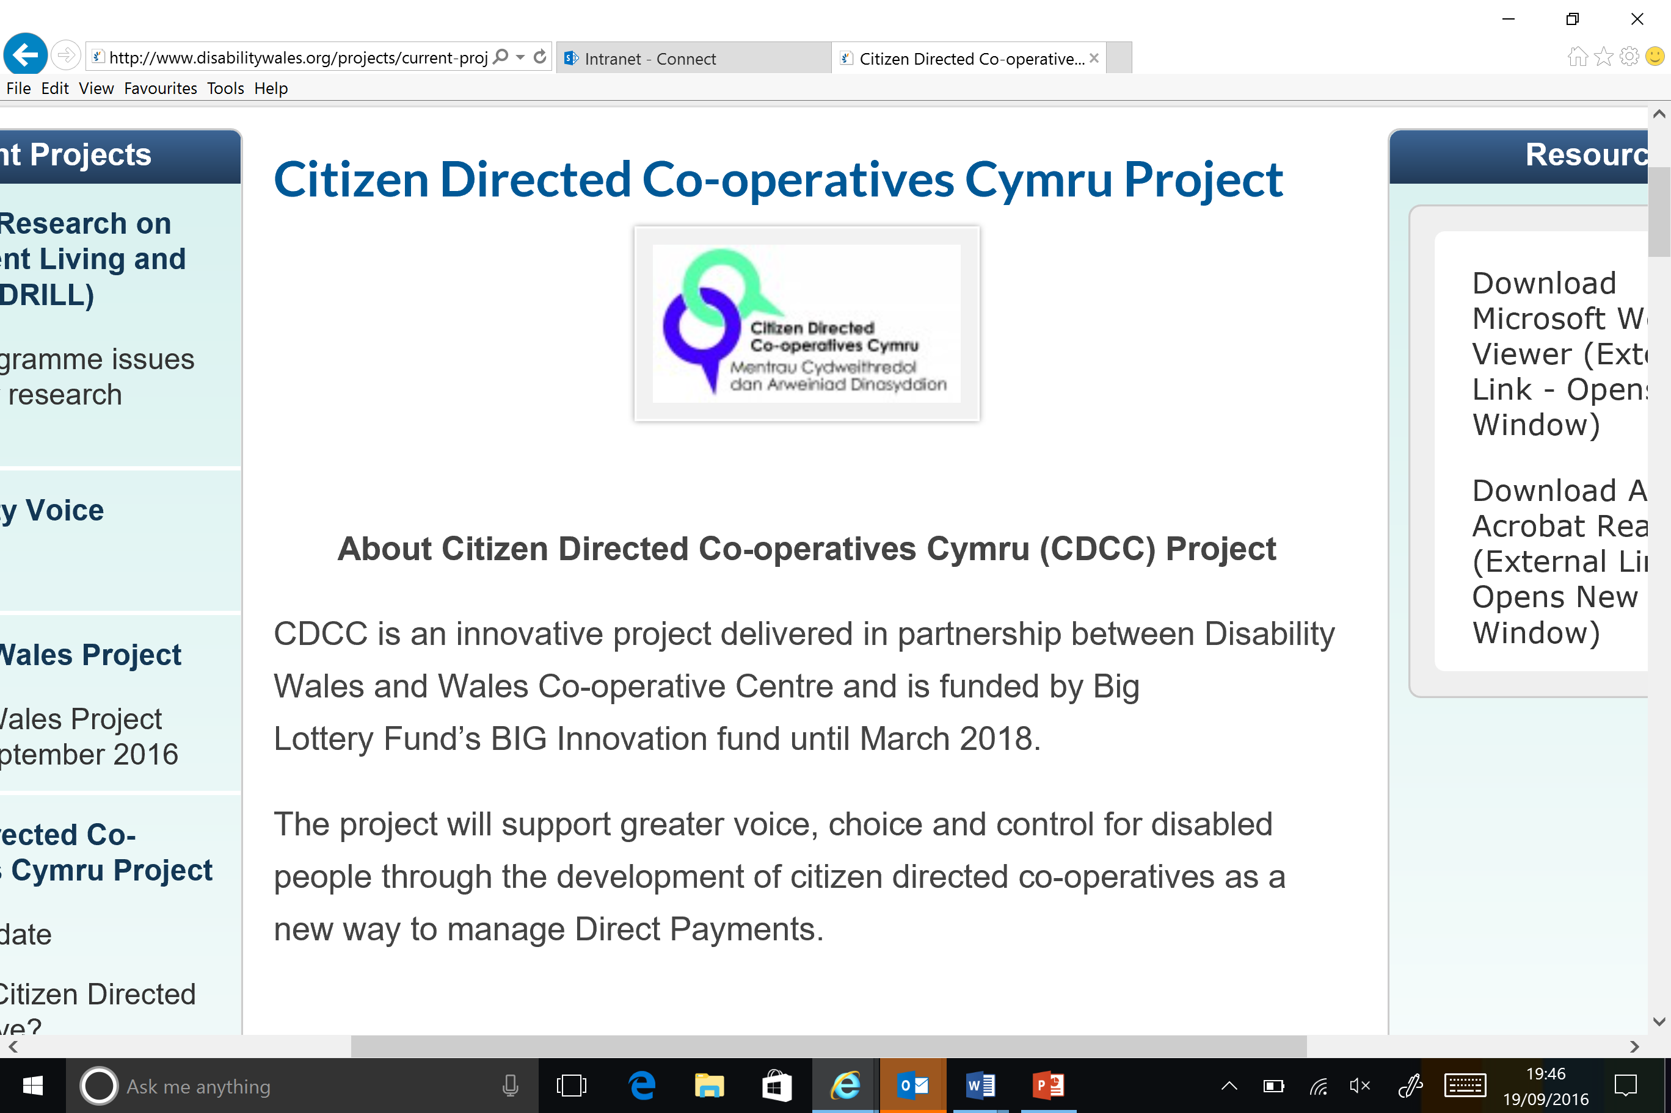

Slide 17
Giving
Is there potential to support existing charities to work smarter through the development of SLA’s. Organisations such as : -
Men’s Sheds
Crossroads
MS Society
Notes:
Is there potential through grant giving to support these charities to develop their capacity to offer products or services to their core constituents

Slide 18
Shopping
Is there potential to procure services from established SE’s to help them grow and develop, organisations such as : -
Age Cymru or Age Connects
Vision 21
Care and Repair Services
Notes:
Vision 21 – Established social enterprise started in Cardiff providing opportunities for people with learning difficulties
Vision 21 offers people with learning needs the opportunity to undertake vocational training with a view to employment, it now has 16 projects covering Catering, Horticulture, Retail, ICT, Woodwork, Pottery, Arts/Crafts and Card Making as well as Training and Mentoring, located around Cardiff, Newport and the Vale of Glamorgan.
Care and Repair Services – Trading arm of Swansea Care and Repair set up to offer handyman services to customers with the ability to pay
Well Being Regeneration - Foot care pilot commissioned by NHS Podiatry Service, local authority, 50+ Partnership/Strategy for Older People with former Carmarthenshire LHB, primarily in Carmarthen
Affordable foot care service no longer available through the NHS
Reduced mobility & lack of exercise have far-reaching physical, social and psychological effects
Service goes beyond standard therapies to include massage, reflexology, physiotherapy & cognitive behavioural therapy to leisure activities and Tai Chi
Aim is to reduce isolation, engage people with their community, reducing the demand for intensive care.
Two thirds income revenue from SLA with LHB/local authority, final third grant investment, supported by in-kind contributions.

Slide 19
Investing
Is there potential for: -
A wholly owned trading arm
A co-operative consortia of existing orgs
A worker co-operative model
A multi stakeholder co-operative in partnership with others
Notes:
Wholly owned trading arm - where a public body like a local authority sets up a wholly owned trading subsidiary to deliver contracted services - Essex Cares Model http://www.essexcares.org/about-us/
Support the process (through investment of time expertise and money) of helping set up a Worker Owned Co-operative Business - CASA Model http://www.casaltd.com/about-us
“ Because our employees have a share in the business our staff turnover is much lower than the private sector
A multi stakeholder co-operative in partnership with others – Where employees, service users and commissioners are equal members of the co-operative.

