Slide 1
Overview Of The National Commissioning Board

Slide 2
Purpose of Session
Remind ourselves of commissioning Cycle
Enhancing our understanding of integrated commissioning.
Foundations of integrated services.
The role & work programme of the National Commissioning Board
Challenges & key questions for regional partnership boards

Slide 3
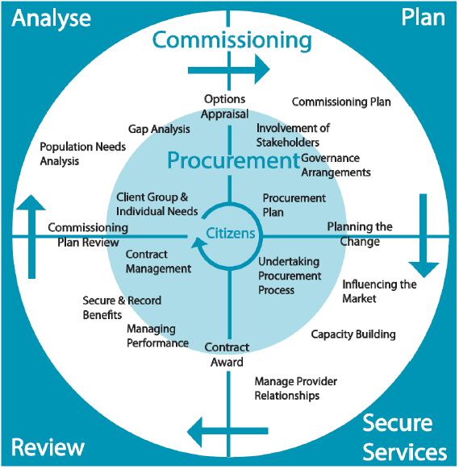
Commissioning Cycle

Slide 4
A Matrix for Analysing Approaches to Commissioning Across Agencies (IPC)
The matrix uses the 4 elements of the commissioning cycle:
Analyse
Plan
Deliver
Review
The matrix also differentiates between the following 4 levels of collaboration:
- Separate Approaches: Actions and decisions are arrived at independently and without co- ordination.
- Parallel Approaches: Objectives, plans, actions and decisions are arrived at with reference to other agencies.
- Joint Approaches: Objectives, plans, actions and decisions are developed in partnership by separate agencies.
- Integrated Approaches: Objectives, plans, actions and decisions are arrived at through a single organisation or network.

Slide 5
Areas | Integrated approaches
Analysis | Single projects undertaking needs analysis and using these to inform common commissioning and contracting priorities. Single research, analysis, or public health teams. Pooled budgets within a single agency or network, to meet combined needs identified for the population via the JSNA.
Plan | Inclusive planning and decision process as an integral partner. A transparent relationship between integrated bodies.
Deliver | Integrated commissioning function, e.g. a single manager with responsibility for managing commissioning and contracting within a single organisation or network.
Review | Integrated monitoring and review arrangements that result in a shared understanding of the effectiveness of current services and the evidence for changes in the future. A single function is responsible for managing and monitoring contracts to meet a single commissioning agenda.

Slide 6
National Commissioning Board
Integrated Commissioning Board with Health Board CE as co –chair plus range of health & social services senior officers.
Representation from each region – regional co-ordinators & commissioners
National Provider Forum representatives – ref. to National Provider Forum
Third Sector
CSSIW, Care Council for Wales & welsh Government
WLGA
Improvement Agencies SSIA / Public Health Wales
Wales Procurement officers
Commitment to engage wide range of stakeholders with each project.

Slide 7
National Commissioning Board : Purpose
To work with partners to provide a improve commissioning & procurement practice.
To promote effective integrated commissioning between local authorities and health boards with robust governance arrangements.
To create a conducive environment with appropriate mechanisms for constructive engagement between commissioners and providers.

Slide 8
National Commissioning Board: Purpose
To support the development of new and sustainable infrastructure for regional commissioning, ensuring that opportunities for collaboration are acted upon.
To improve our systems for collecting market intelligence
To share learning about new developments in commissioning
The work program of the NCB will inform & support the development of the plans required of each regional partnership board.

Slide 9
National Commissioning Board Current Work Program
Market Analysis Care Homes
Model Partnership Agreement for the integrated commissioning of services from care homes including governance arrangements & management information requirements.
Specification for Care Homes / Home Care – taken forward with standards being developed for R & I Act.
Care at Home Strategy – The production of a toolkit to develop an outcomes focused approach to care at home services – specification – payment systems focused on delivering outcomes – working with micro enterprises, etc
Options for Securing Services that promote person centred care & a sustainable good quality workforce

Slide 10
National Commissioning Board Work Program (continued)
Examining the skills & capacities of commissioners
Development of guidance for integrated commissioning of services for people with learning disabilities which be accompanied by a range of tools focused on the effective commissioning of specific services – supported accommodation; daytime occupation / sheltered employment, specialist health services, positive behavioural support.
Children with Complex Needs
Concordant to promote constructive working relationships between commissioners and providers.

Slide 11
Area Plans
Each population needs assessment report must include specific core themes dealing with:
children and young people;
older people;
health/physical disabilities;
learning disability/autism;
mental health;
sensory impairment;
carers who need support; and
violence against women, domestic abuse and sexual violence.
The area plans should set out the specific services planned in response to each core theme identified in the population assessment report.

Slide 12
Regional Partnership Boards – Commissioning Priorities
Older people with complex need and long term conditions, including dementia
People with learning disabilities;
Carer, including young carers
Integrated Family Support Services: and
Children with complex needs due to disability or illness.
Area plans must set out what actions partners will take to prioritise integration of services in these areas.

Slide 13
Regional Partnership Board workshop questions
Cwestiynau gweithdy ar gyfer y Byrddau Partneriaeth Rhanbarthol
1. What should regional partnership boards be doing to prepare for joint commissioning in 2018?
2. What are the regional partnership boards commissioning priorities?
3. How can partners work together to make the most effective use of assets and avoid duplication of effort both of commissioners and providers?
4. Do you have the capacity to deliver on your integrated commissioning agenda?
5. What does Welsh Government need to do to support the requirement to undertake commissioning?
1. Beth y mae’n rhaid i chi’r byrddau partneriaeth rhanbarthol ei wneud i baratoi ar gyfer comisiynu ar y cyd yn 2018?
2. Beth yw eich blaenoriaethau comisiynu?
3. Sut gall partneriaid weithio gyda’i gilydd i sicrhau eu bod yn defnyddio asedau yn y ffordd fwyaf effeithiol, ac yn osgoi dyblygu ymdrechion comisiynwyr a darparwyr?
4. A oes gennych y capasiti i gyflawni eich agenda comisiynu integredig?
5. Beth sydd angen i Lywodraeth Cymru ei wneud i gefnogi’r gofyniad i ymgymryd â gwaith comisiynu?

