Slide 1

Third Sector Engagement: Children with Disabilities and Illness
Jim Crowe
Regional Partnership Board Workshop
Catrin Finch Centre, November 2nd Wrexham

Slide 2
LDW Mission
‘Creating a Wales that values every child, young person and adult with a learning disability’
We are an umbrella body with 80 member organisations: service providers, advocacy groups, carer groups

Slide 3
LDW activities
We provide:
Information through publications and social media
Training across Wales
Policy and campaigns work
and
undertake projects that promote good practice in services

Slide 4

Project Activity 1
Early Support
- age 0-5 delivery partner with
Welsh Govt 2009-13. All Wales
Real Opportunities project
- age 14-18 helping young people
in transition. South and West Wales

Slide 5


Project Activity 2
Engage to Change
- age 16-21 helping young
people into real jobs 2016- 2021. All Wales
Valued Lives
- assisting implementation
of SSWB Act 2016-19. All Wales

Slide 6
RPB responsibilities 1.
152. Section 15 of the Act …. local authorities must provide or arrange for the
provision of a range and level of preventative services:
a) Contribute to preventing or delaying development of people’s needs for care and support
b) Reduce need care and support of people who have such needs
c) Promote upbringing of children by families, where consistent with well-being of child
d) Minimise effect on disabled people of their disabilities
e) Contribute towards preventing people from suffering abuse or neglect
Part 2 Code of Practice (General Functions)

Slide 7
RPB Responsibilities 2.
155. Prevention is at the heart of the Welsh Government’s programme of change for social services. There is a need to focus on prevention and early intervention….to make social services sustainable….. It is vital that care and support services do not wait to respond until people reach a crisis point. The preventative approach includes promoting children being brought up by their families and preventing children becoming looked after.
Part 2 Code of Practice (General Functions)

Slide 8

RPB responsibilities 3.
160. Local authorities should work collaboratively and with a variety of partners and stakeholders, including Local Health Boards, to develop and deliver required range and level of preventative services….local authorities may choose to provide some types of preventative services themselves, others may be more effectively provided or arranged in partnership with other local partners including … third sector.
Part 2 Code of Practice (General Functions)

Slide 9
RPB responsibilities 4.
162. Within the local authority, preventing or delaying the development of care and
support needs should be closely aligned to other local authority responsibilities,
such as housing, leisure and education, including adult education.
Part 2 Code of Practice (General Functions)

Slide 10
RPB responsibilities 5.
185. Identifying preventative services that help people to learn, keep or improve skills and functional ability is integral to promoting well-being. As with reablement, effective habilitation should support physical, sensory, social and emotional needs…..one that focuses on the specific needs of the individual and their family.
Part 2 Code of Practice (General Functions)

Slide 11
RPB responsibilities 6.
189. The Act draws heavily on children in need and well-being elements of the 1989 and 2004 Children Acts. There has been no diminution in the rights and entitlements of children. The Act reinforces the principle of supporting families in caring for children with an emphasis on helping parents develop their own ability to identify and manage problems, keeping families together in a safe, supportive and stable environment. Local authorities must embed this principle in their planning and service delivery.
Part 2 Code of Practice (General Functions)

Slide 12
RPB & Third Sector 1.
219. Welsh Govt Third Sector Scheme definition:
Independent, non-governmental bodies
Established voluntarily by people who choose to organise themselves
Value-driven, motivated by social, cultural or environmental objectives rather than simply to make a profit
Committed to reinvesting their surpluses to further their social aims and for the benefit of people and communities in Wales.
Part 2 Code of Practice (General Functions)

Slide 13
RPB & Third sector 2.
227. Section 14 population assessment must include identification of range and level of services necessary to meet need. It should also assess what is provided by social enterprises, co-operative organisations and arrangements, user led services and the third sector.
Part 2 Code of Practice (General Functions)

Slide 14
RPB & Third sector 3.
237. …essential to fulfilling this duty…an approach based on co-production principles:
Recognises people as assets, having a positive contribution to make to design and operation of services
Supports and empowers people to get involved with design and operation of services
Empowers people to take responsibility for, and contribute to own well-being
Ensures that practitioners work in partnership with people to achieve personal outcomes at an individual and service level
Involves people in designing outcomes for services.
Part 2 Code of Practice (General Functions)

Slide 15
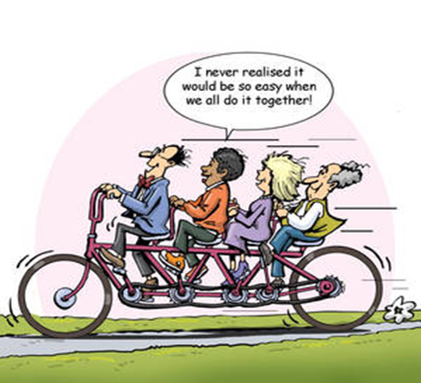
Third sector role
Support the building of networks and community services
which meet the needs of local people
Seek to co-produce services with local people
Promote development of new service models of delivery
Ensure availability of preventative services
Support development of integrated services
Getting in on the Act Learning Hub, Care Council

Slide 16
Children with disability or illness 1.
20. …develop an integrated approach to delivering services for children with complex needs, due to disability or illness and for children and young people with mental health problems. This includes transition arrangements from children to adult services.
Part 9 Statutory Guidance (Partnership Arrangements)

Slide 17
Children with disability or illness 2.
60. Welsh Government will expect to see an integrated approach to the development of early intervention and preventative services.
Part 9 Statutory Guidance (Partnership Arrangements)

Slide 18
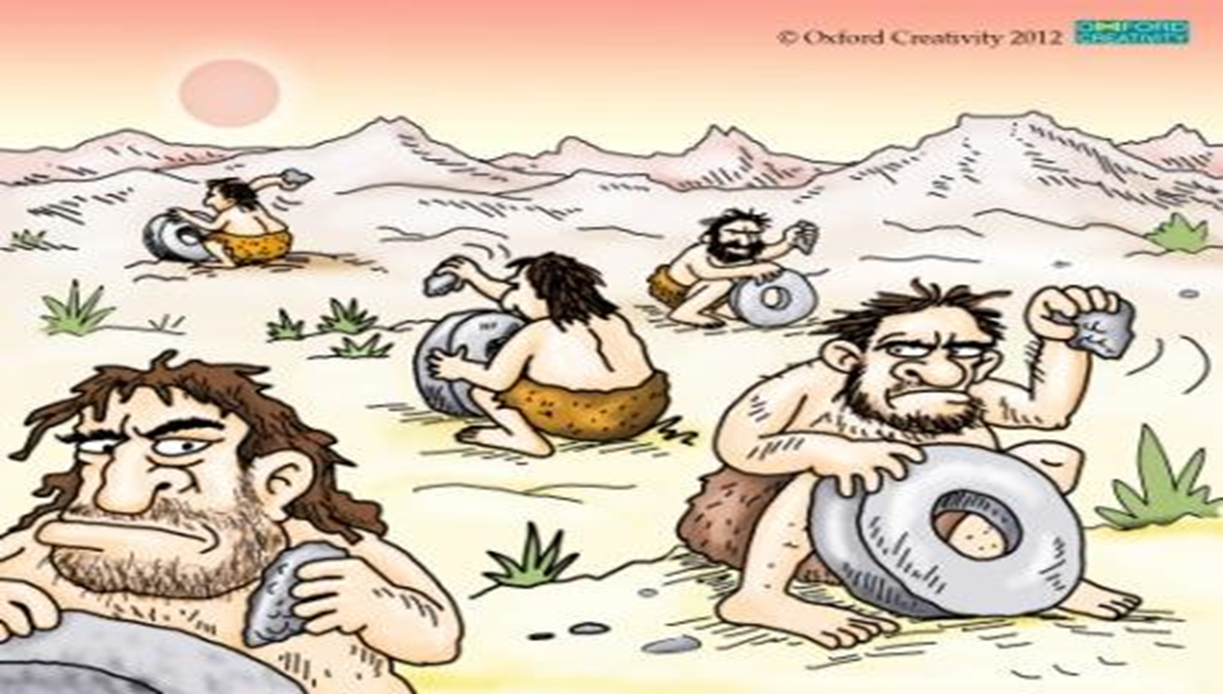
What does best practice look like?
NSF for Children, Young People & Maternity Services 2005

Slide 19
What does best practice look like for children?
For a disabled child:
An assessment of each child’s needs and strengths, including diagnosis
Prompt delivery of services to meet assessed needs
Provision of educational support to maximise cognitive development
Encouraging social development through inclusive policies and practices
Provision of family support to maximise emotional development
Provision of services which respect each child’s views, language and culture.
NSF for Children, Young People & Maternity Services 2005

Slide 20
What does best practice look like for families1.?
For families of disabled children:
Clear and accurate information to empower them to make informed choices and gain access to help when they need it
Practical support to assist them in caring for their child
Access to emotional support when they need it
Access to leisure
NSF for Children, Young People & Maternity Services 2005

Slide 21
What does best practice look like for families 2.?
Advice on how to maximise child’s development and offer training if needed
Access to affordable childcare and other services to enable parents to return to work
Provision of short breaks and additional services to enable family to participate in same lifestyle that parents of non disabled children experience
NSF for Children, Young People & Maternity Services 2005

Slide 22
Early support principles 1.
Wherever possible, families are able to live ‘ordinary lives’
Uniqueness of children and families is valued and provided for
Care based on joint assessment, planning and review processes that keep parents and carers at heart of discussion/decision-making
Children and families experience service delivery as holistic, co-ordinated and seamless, facilitated by a key worker
Families experience continuity of care through different phases of engagement with services

Slide 23
Early support principles 2.
Children’s learning and development is monitored and promoted
Families are able to make informed decisions
Families and children are involved in shaping and developing services
Working practices and systems are integrated
Families can be confident that people working with them have training, skills and experience required to meet child’s needs.

Slide 24
Will you help or hinder?
A profound shift in appraoch is still required if agencies are work in an effective integrated way.
A practitioner who works with children with a profound and multiple learning disability:
“ Why is a specialist chair considered to be a health need only, by local authorities? And then, why is a specialised bed, required with a sleep system for parents to move and handle a person, considered to be a social need by some health boards?”

Slide 25
Thank you for your attention
Jim Crowe
Director, Learning Disability Wales
President, European Association of Service Providers for People with Disabilities EASPD
Jim.crowe@ldw.org.uk
www.ldw.org.uk

